Slide 1
ZA CTD practical application – some Do’s & Don’ts
Estelle Taute

Slide 2
Overview
Format of submissions
Latest changes to CTD
Presentation
  General
  P&A
  Clinical

Slide 3
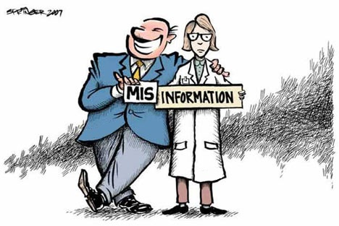
Why are there still challenges?
Communication?
Training?
Attitude?
Corporate pressure?

Slide 4
Format of submissions
Pre-registration responses & post-registration follow-up stability data:
  comply with Amendments guideline 1 and 6
  format of the application for registration if still MRF1
Post-registration amendments Type A, B and C - 1 June 2011
No hybrids for new submissions

Slide 5
Latest changes to ZA CTD
1.7.7 Proof of current registration of the Responsible Pharmacist by the SAPC registration
1.7.7.1 Proof of current registration of the Responsible Pharmacist by the SAPC
1.7.7.2 Proof of current registration by the SAPC of the pharmacist signing the dossier
1.7.7.3 Proof of registration of the Applicant/PHCR as a pharmacy or a pharmacist
1.7.8 Registration with the Registrar of Companies
  Submit a copy of the certificate of registration of the company with the Registrar of Companies (if relevant).

Slide 6
Latest changes to ZA CTD cont.
1.7.9 Other documents relating to the Applicant/PHCR
1.7.9.1 Letters of cession and acceptance
  When an application for transfer of applicancy is submitted, include the letter of cession from the current applicant (HCR) and letter of acceptance from the proposed applicant (PHCR) here.
1.7.9.2 Company letterheads
  When an application for transfer of applicancy is submitted, or the name of the applicant or address is changed, include the old and new company letterheads here.

Slide 7
Latest changes to ZA CTD cont.
Module 1.3 South African labelling and packaging
Applicants should include the proposed or approved texts of Package Insert (PI) (Module 1.3.1) and Patient Information (PIL) leaflet (Module 1.3.2). South African specific labels should be submitted in Module 1.3.4 1.3.3 (mock-ups, specimens or text).

Slide 8
Presentation
Information not readily retrievable
PARTs not indexed properly
Volumes not indexed
CTD sections not identified with tabs, dividers or page numbers
Reproduced documents should be clear and legible
  Cf SA Guide to GMP chapter 4

Slide 9
Presentation cont.
Photocopies
Illegible
Left-hand margin too narrow - text not visible
Page numbers cut off
Double-sided copies not utilised (excl PI)
Notes:
Single-sided: results in paper waste and more volumes of documents

Slide 10
Presentation cont.
Thickness and binding of ALL documents
Left-hand margin - sufficiently large that information is not obscured through binding
Avoid shading and/or coloured filling/background and/or print, e.g. in tables and headers
Binders – no metal file fasteners
Units not to exceed 4 cm including binder

Slide 11
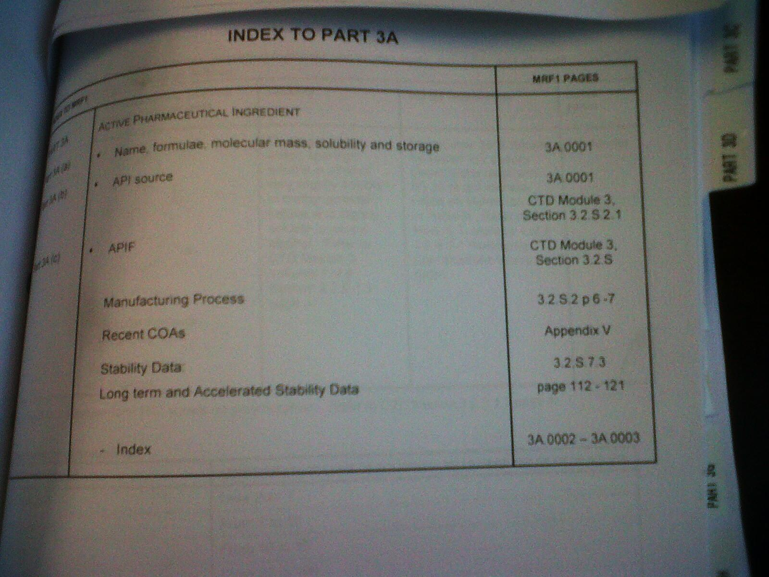
MRF1?
What will the baseline be for amendments?

Slide 12
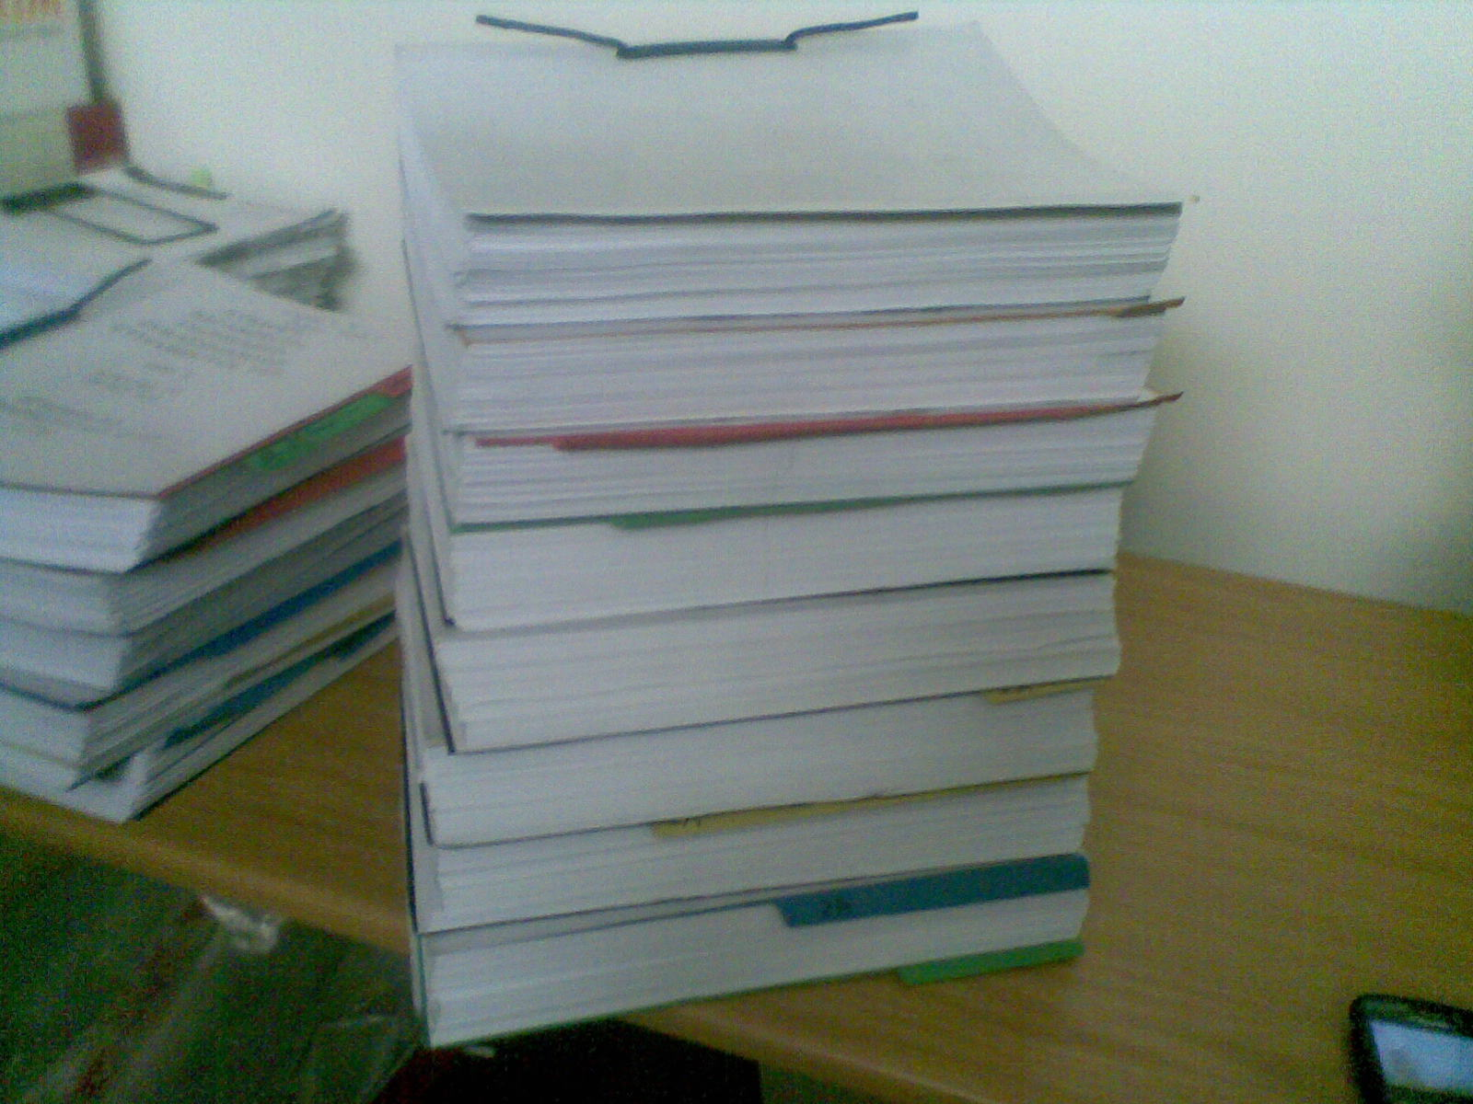
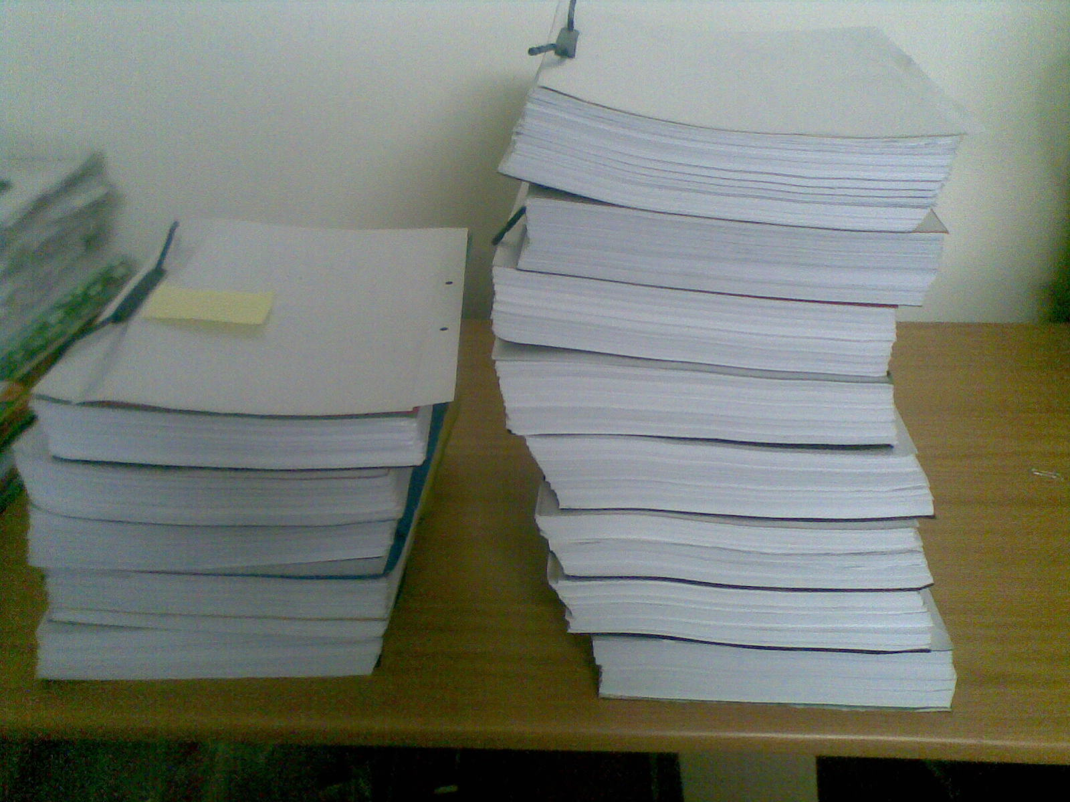
Presentation

Slide 13
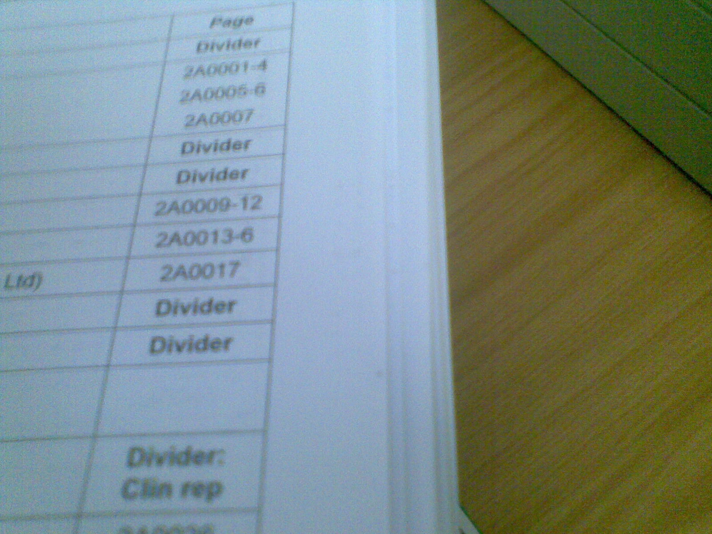
Presentation cont.

Slide 14
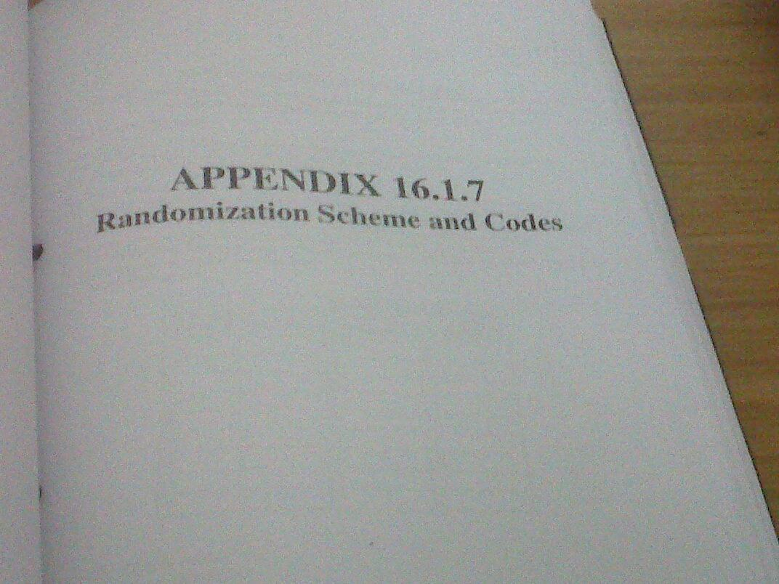

Presentation cont.

Slide 15
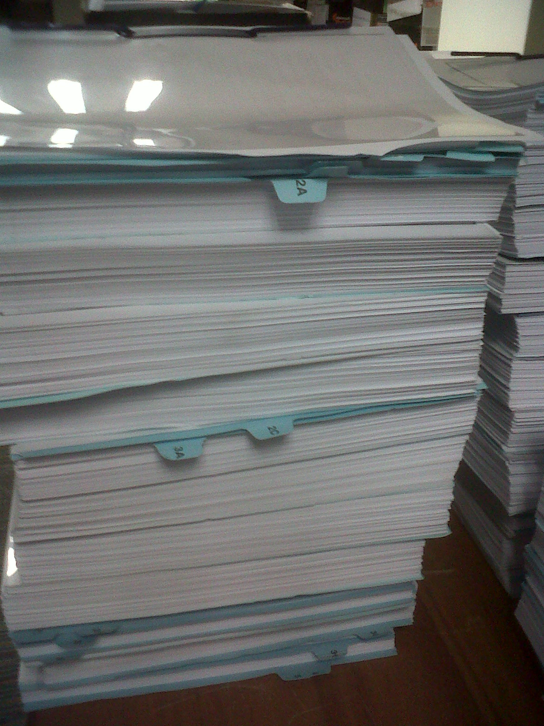
Presentation cont.

Slide 16
Other
Signing of submissions
S.I. requirements - documents completed locally must conform – includes PI
  Not documents compiled / originating from elsewhere

Slide 17
Responses
Responses to P&A in amendment format not evaluator friendly
  Amendment schedule
  Reply not in P&A sequence
Handwritten content changes – not good regulatory practice
Responses not adequate/ meaningful
Data not included in PARTs/Modules

Slide 18
Amendments
Proprietary name changes
  Before registration only if required by Council
Transfer of applicancy
  Don’t assume approval
Manufacturer changes
  Appendix A1 (1.5.2.2), A2 (1.5.2.3)
Technical amendments
  Insufficient detail in amendment schedule (1.5.2.1)
  Incorrect category
CTD comprehensive ToC not included
Notes:
App A1 Misrepresentation of what has been approved
What will inspectorate find if they should do a product compliance inspection?
E-mail could result in contravention of section 34

Slide 19
Amendments cont.
Module 1.0 Letter of application
Module 1.1 Comprehensive table of contents
Module 1.2.1 Application form
1.5.2 Amendments / Variations
1.5.2.1 Tabulated schedule of amendments (refer to Amendments Guideline)
1.5.2.2 Medicines Register Details (Appendix A1 of the Amendments Guideline)
1.5.2.3 Affidavit by Responsible Pharmacist (Appendix A2 of the Amendments Guideline)
  To be on company letterhead, signed by RP
Resubmission of amendments – contact unit

Slide 20
Clinical
Apply previous Clinical Committee recommendations when compiling new PIs and PILs
The guidelines clearly stipulate that British English be used for PIs/PILs.
  Remember to spel cheeck
Remove raw data – Module 5
Include copy of CC Recommendation in response
  Also additional recommendations

Slide 21
Clinical cont.
State full date of submission
  Full date (day, month, year) - for scheduling of evaluation on the first-in-first-evaluated principle.
  Unacceptable to date a first time submission, any correspondence or a response as e.g. “Nov 2011”
Include original (post-screening) date of submission
  This date is vital for ALL evaluator reports.
Do not post-date submissions

Slide 22
Package insert
PI/PIL pages should always be dated and numbered
Follow the stipulated format for the PROPOSED annotated PIs
Leave a column at least 3 to 4 cm on the right hand side of each page of the PI.
  Include references and later comments in this column.
Cross-referencing to be clear
  Supportive data are often referred to as Ref 1 or 2 only.
  Evaluators have to read through entire monograph to find appropriate statement.

Slide 23
PIL
Frequencies should not be mentioned in PILs.
Side-effects should be listed as
  those requiring urgent medical attention, e.g. anaphylactic shock symptoms (even if less frequent);
  those where a patient should immediately contact their doctor;
  those where patient should tell and ask doctor, pharmacist, or healthcare professional for advice.

Slide 24
What happens if Regulatory is a Post Box?
  Inadequate dossier
  Back to ◻ 1
What happens if Regulatory knows guidelines and applies its mind?
  Greater chance of success

